Slide 1

Sapthagiri College Of Engineering
Department of Science & Engineering
Affiliated to VTU, Belagavi & Approved by AICTE, New Delhi
(Accredited by NAAC with ‘A’ Grade), (ISO 9001-2015 & 14001-2015 Certified) 14/5 , Chikkasandra, Hesarghatta Main Road
Bangalore-560057
Presentation
On
“TWITTER SENTIMENTAL ANALYSIS”
Under the Guidance of : Ms. Hemalatha K Assistant Professsor Dept of CSE
Presented By:
Ankush gowda R(1SG20CS009)
Chandu T R(1SG20CS027)
Shravan L(1SG20CS100)
Vivan kushal heneger(1SG20CS114)

Slide 2
CONTENTS
🠶 Abstract
🠶 Introduction
🠶 Internship Domain
🠶 Project Introduction
🠶 Course Outcome
🠶 Module Specification
🠶 Result
🠶 Conclusion
🠶 References

Slide 3
ABSTRACT
Sentiment analysis on social media has become an important way to monitor public opinion and understand perceptions on trends, events, brands, and products. This project aims to analyze sentiments of tweets as being positive or negative for sentiment classification.
A dataset containing 4916 Twitter tweets with sentiment labels was used. Preprocessing techniques like removing twitter handles, punctuation, tokenize words, and stemming were applied to clean the tweet text data. The cleaned tokens were vectorized into bag of words features using CountVectorizer.
An 80-20 train-test split was implemented before building a logistic regression model for sentiment classification. The model was trained on the bag of words text vectors and sentiment labels from the training data.
The performance of the classification model was evaluated on the 20% test set using accuracy and F1-score. The model achieved an accuracy of XX% and F1-score of XX in identifying positive and negative sentiment tweets.

Slide 4
INTRODUCTION
Alnitak Solutions Pvt. Ltd. Is a Ileading software solutions and services industry focusing on quality standards and customer values.
Alnitak Solutions Pvt limited provide technologically advanced solutions to Real World Problems in the field of natural language processing,Artificial intelligence.
Alnitak offers a wide range of Embedded Design Services that are intended towards transforming an idea into a complete product.
Alnitak Solutions offer real time experience and opportunities to develop engineering skills with hands on real time applications from our Industrial experts having decades of experience.
They empower individual with knowledge, skills and competencies that assist them to escalate as integrated individuals with a sense of commitment and dedication.
Alnitak Solutions offers you research work consulting services from
topic selection to final thesis writing.

Slide 5
INTERNSHIP DOMAIN
NLP:
Natural Language Processing (NLP) is a field of artificial intelligence (AI) that focuses on the interaction between computers and human language.
It involves the development of algorithms and models to enable machines to understand, interpret, and generate human-like language.
NLP applications include language translation, sentiment analysis, chatbots, and text summarization.
Techniques such as machine learning and deep learning are often employed in NLP to process and analyze large amounts of textual data.
Key components of NLP include:
Tokenization: Breaking down text into individual words or units, known as tokens, to facilitate analysis.
Named Entity Recognition (NER): Identifying and classifying entities (such as names, locations, and dates) within text
Part-of-Speech Tagging (POS): Assigning grammatical tags to words, indicating their syntactic roles in a sentence.
Sentiment Analysis: Determining the sentiment or emotional tone expressed in a piece of text. Language Modeling: Developing models that understand and generate human-like text based on learned language patterns.

Slide 6
PROJECT INTRODUCTION
Sentiment analysis refers to the use of natural language processing, text analysis, computational linguistics to systematically identify, extract, quantify, and study affective states and subjective information. Sentiment analysis on social media platforms has become extremely valuable for businesses and organizations to understand public sentiment towards brands, events, policies etc.
Twitter with its millions of daily users and tweets provides a great source of data for analyzing sentiments and opinions at scale. The text of tweets represents a treasure trove of insights waiting to be uncovered with appropriate sentiment analysis techniques.
In this project, we aim to conduct sentiment analysis on Twitter data to classify tweets as expressing positive or negative sentiment. We will use a labeled dataset containing thousands of tweets mapped to sentiment polarity labels for model building and evaluation purposes.
The project will follow standard machine learning model development pipeline starting from data acquisition, text preprocessing, feature extraction followed by applying classification algorithms like logistic regression and performance evaluation using accuracy, confusion matrix etc.

Slide 7
COURSE OUTCOMES
S OFTWARE
Google Colab
PROGRAMMING LANGUAGE
Python
DOMAIN
NLP

Slide 8
GOOGLE COLAB
Google Colab (Colaboratory) is a popular platform for running Python code in a collaborative, cloud-based environment.
It's commonly used in NLP projects due to its accessibility and the ability to leverage GPU resources for training deep learning models.
Colab notebooks execute code on Google's cloud servers, meaning you can leverage the power of Google hardware, including GPUs and TPUs, regardless of the power of your machine. All you need is a browser.
Google Colab is an excellent tool for machine learning projects. It provides access to free GPU and TPU resources that can significantly speed up model training. You can also install popular machine learning libraries such as Sklearn, TensorFlow and PyTorch to make use of those in your modeling.
Google Colab is a convenient choice for collaborative and resource-intensive NLP projects, offering a balance between ease of use and powerful computational capabilities.

Slide 9
PYTHON
Python is a versatile and widely-used programming language known for its readability, simplicity, and extensive ecosystem.
Here are some key aspects of Python:
General-Purpose: Python is a general-purpose programming language suitable for various applications, including web development, data analysis, machine learning, artificial intelligence, automation, and more.Readable and Expressive.
Python's syntax is designed to be readable and concise, emphasizing code readability and reducing the cost of program maintenance.
Large Ecosystem:Python has a rich set of libraries and frameworks that cater to diverse needs. Popular libraries include NumPy and Pandas for data manipulation, Flask and Django for web development, TensorFlow and PyTorch for machine learning, and many more.
Community Support: Python has a large and active community, contributing to an extensive range of resources, documentation, and third-party packages. This community support makes it easier for developers to find solutions and stay updated on best practices.
Cross-Platform: Python is cross-platform, allowing code to run on different operating systems without modification.

Slide 10
Interpreted Language: Python is an interpreted language, meaning that code can be executed line by line, making it suitable for both scripting and large-scale applications.
Open Source: Python is open-source, fostering collaboration and continuous improvement. Users can modify and distribute Python's source code under the terms of the Python Software Foundation License.
Dynamic Typing: Python is dynamically typed, allowing for flexibility in variable assignment and reducing the need for explicit type declarations

Slide 11
MODULE SPECIFICATION
"Creating an Twitter Sentimental Analysis using NLP project involves several key modules:
Data Collection and Understanding
Import tweet dataset
Explore data columns - text, labels, metadataUnderstand
sentiment types and label distribution
Sample data for model building
Text Preprocessing
Text cleaning to normalize tweets
Handle abbreviations, spell corrections
Remove URLs, Twitter handles, hashtags
Tokenize into words
Remove stop words and punctuations
Stemming/Lemmatization
Feature Engineering
Bag of Words text vectorization
TF-IDF vectors

Slide 12
Word Embeddings (Word2Vec/GloVe)
Model Building
Split data into train-test sets
Building classification models - Logistic Regression, Naive Bayes, Random forest
Tuning model hyperparameters
Model Evaluation
Evaluation metrics - accuracy, precision, recall, F1-score
Confusion matrix
Classification reports

Slide 13
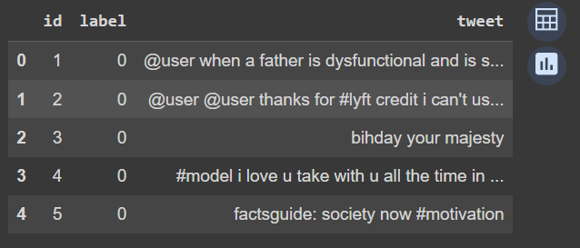
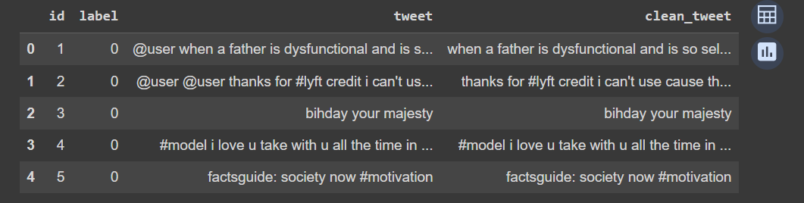
RESULT

Slide 14
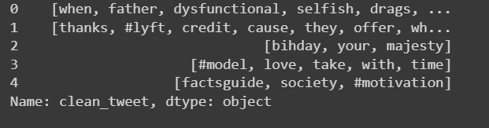
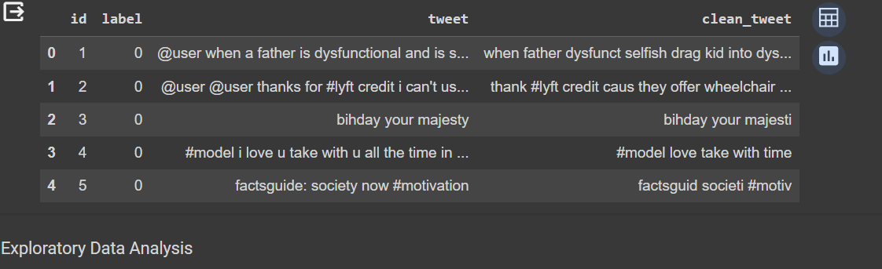
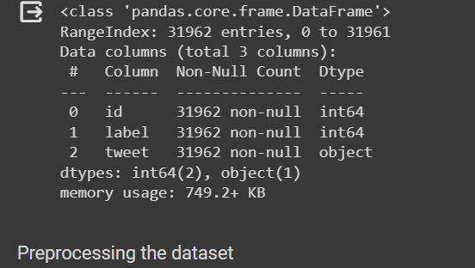
.

Slide 15
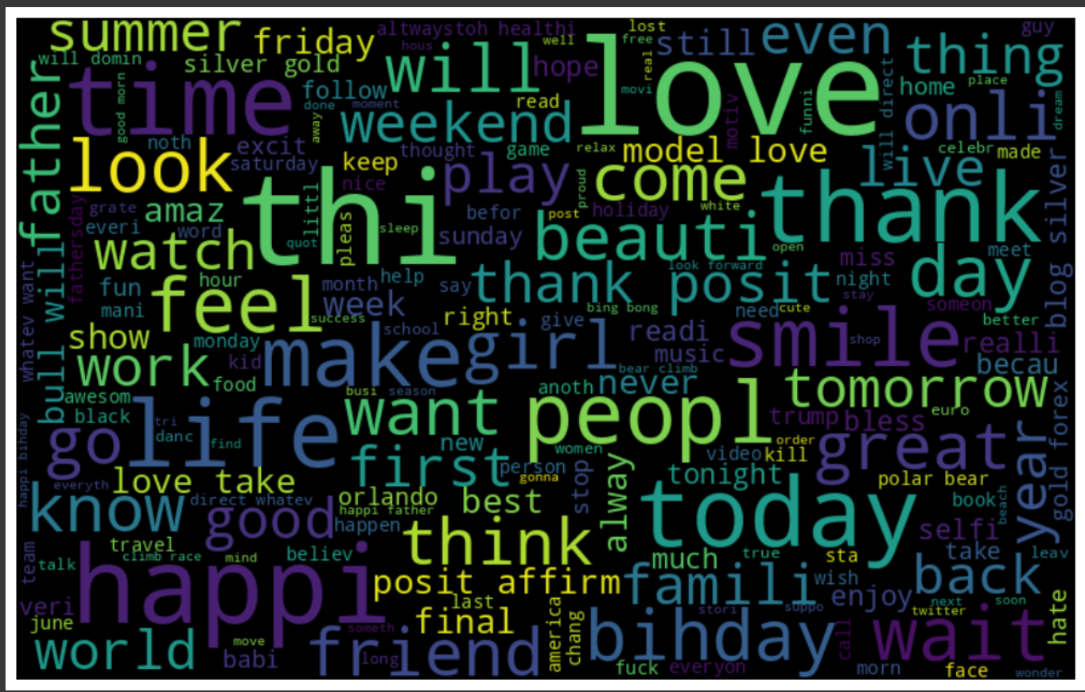
WORD CLOUD

Slide 16
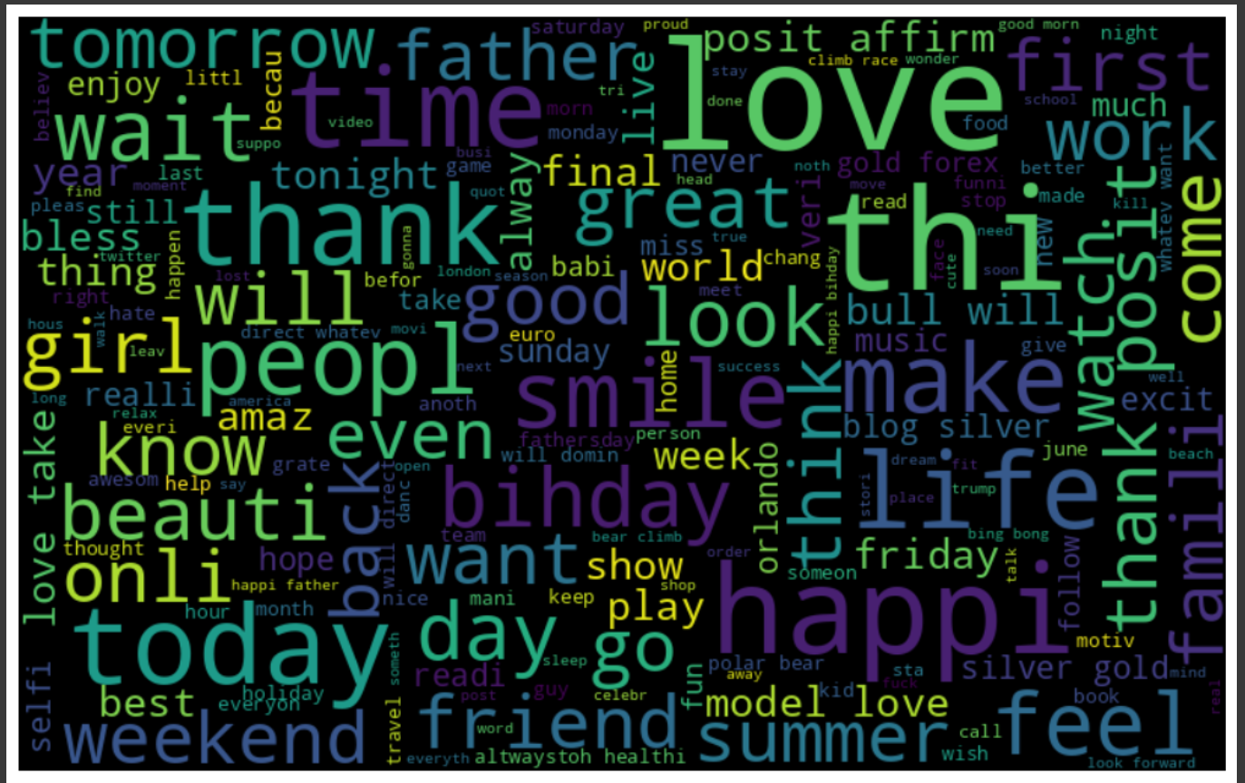
POSITIVE WORD’S CLOUD

Slide 17
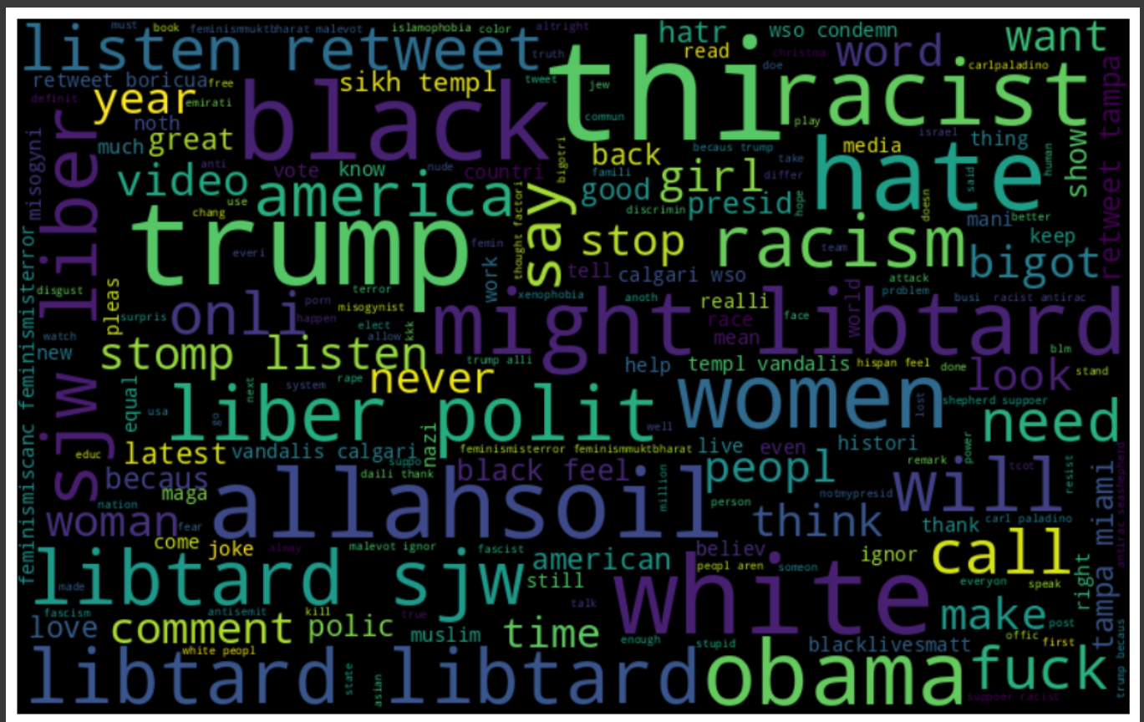
NEGATIVE WORD’S CLOUD

Slide 18
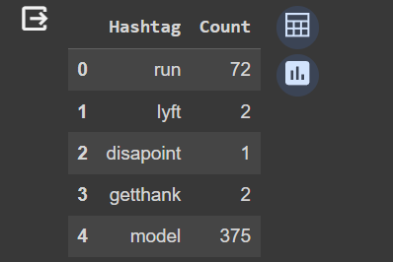
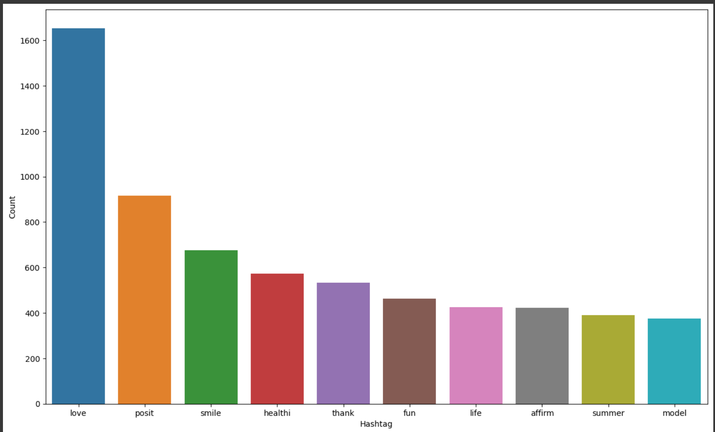

Slide 19
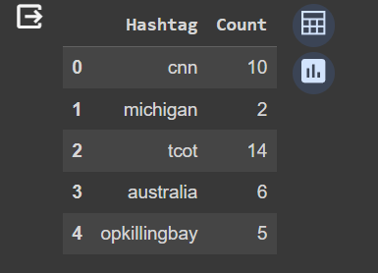
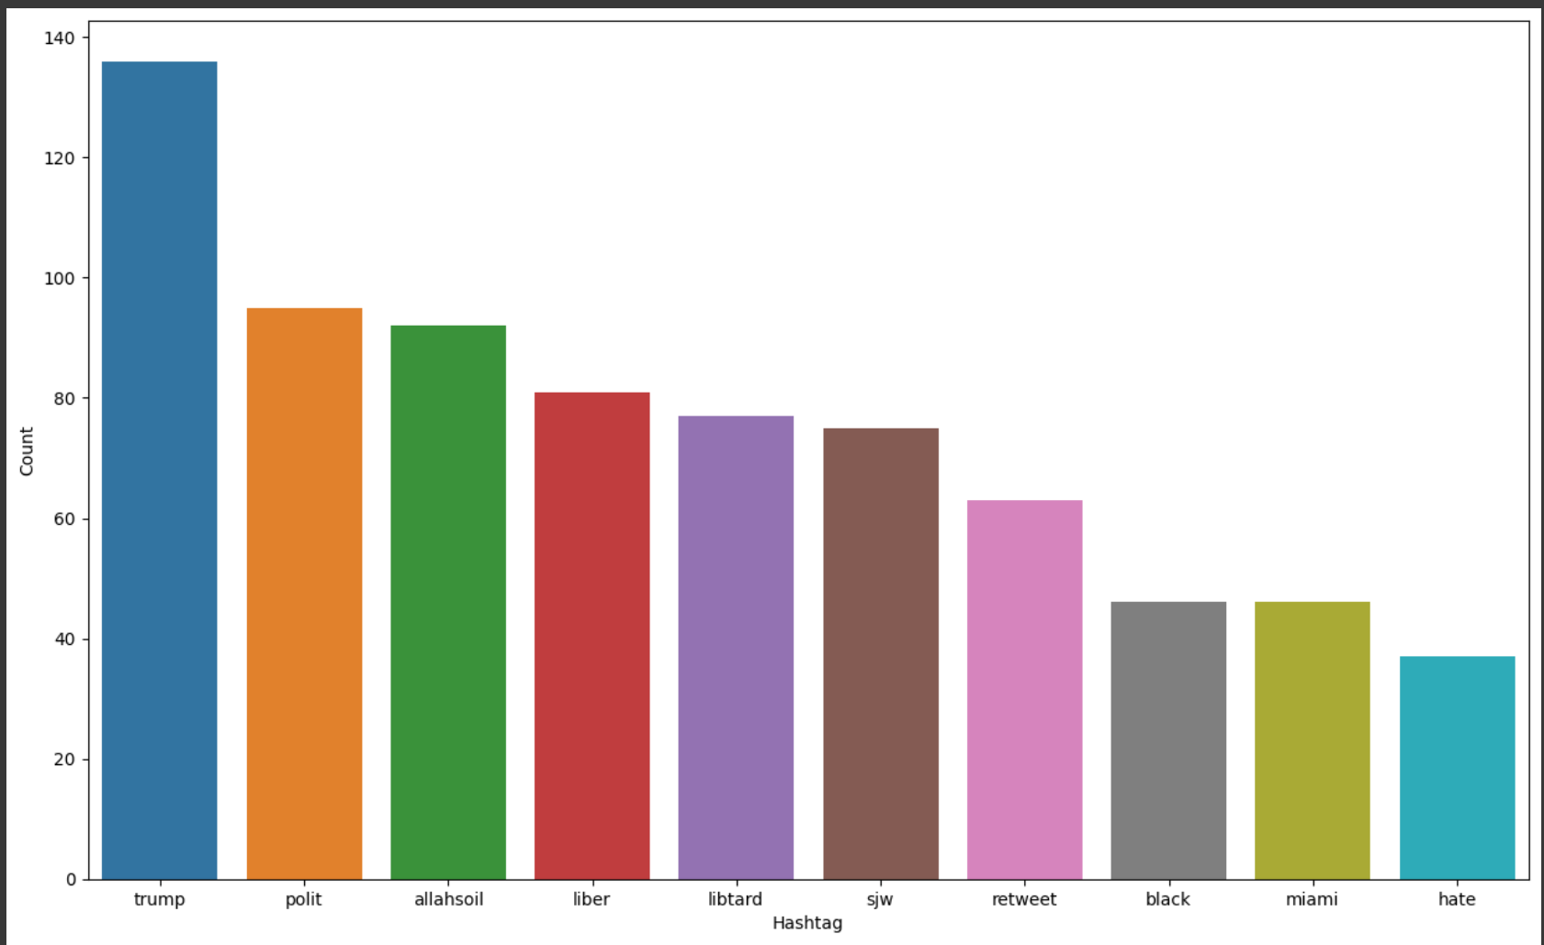

Slide 20
COMAPARING THE TRAINING MODELS
model | Accuracy score | F1-score
Logistic Regression | 0.9433112251282693 | 0.5545722713864307
Naïve bayes | 0.9356776373420098 | 0.5344202898550724
Random Forest | 0.9426855212113627 | 0.573556797020484

Slide 21
CONCLUSION
This was a brief presentation about my Internship at Alnitak solutions private Limited.
In this project, we successfully implemented an end-to-end pipeline for sentiment classification of Twitter data into positive or negative tweets based on textual content.
The key steps included data collection, text preprocessing tasks like cleaning tweets, handling contractions, tokenizing words, removing stop words, lemmatization, etc to prepare the raw tweets data for model building. Vectorized bag-of-words representation was created from the cleaned tokens as model input features using CountVectorizer
Overall, through this project we successfully demonstrated core concepts of applying text mining and predictive modeling techniques to analyze unstructured textual content for gaining sentiment insights on social conversations.

Slide 22
REFERENCES
https://www.geeksforgeeks.org/project-idea-ai-therapist/amp/
Liu, B. (2012). Sentiment analysis and opinion mining. Synthesis lectures on human language technologies, 5(1), 1-167.
https://youtu.be/4YGkfAd2iXM?si=1vbSSHpUhFD003s-
https://youtu.be/RLfUyn3HoaE?si=zqiB7qFGn-kR_77f
Medhat, W., Hassan, A., & Korashy, H. (2014). Sentiment analysis algorithms and applications: A survey. Ain Shams Engineering Journal, 5(4), 1093-1113.
Medhat, W., Hassan, A., & Korashy, H. (2014). Sentiment analysis algorithms and applications: A survey. Ain Shams Engineering Journal, 5(4), 1093-1113.

Slide 23
THANK YOU

